Slide 1
Projectgroep burgerschap
Lesson ‘SNOW’
A lesson on
Things known and unknown
Identity
Being brave

Slide 2
Klas 1 – ERK-niveau A1/A2
Lesson – SNOW
Chapter 1 of the book ‘Home of the Brave’
by Katherine Applegate

Slide 3
Lesson plan + goals
Je leert deze les:
je te verplaatsen in het perspectief van een ander
verschillen, overeenkomsten en stereotypen benoemen
Think about something you all know (snow)
Read ‘Snow’
New vocabulary? Make a list
Understand the text. Answer the questions.
Talk about what it means to be new in another country – what is strange?
Look at the title of the book: ‘Home of the brave’ + look at the American National Anthem.
Write about something that is new.

Slide 4
SNOW think – pair - share
1. Think about snow. Say in four words what snow is like.
Snow is:
…………………..
…………………….
…………………….
…………………….
2. Compare your answers with your neighbour. What are the best descriptions (beschrijvingen)?
……………………………….
……………………………….
……………………………….
……………………………….
Notes:
Voordat de leerlingen starten met het kijken van het filmpje is het belangrijk om voorkennis te activeren en na te denken over welk beeld ze van Franstalig Afrika hebben en waar dit beeld vandaan komt.

Slide 5
Read ‘SNOW ’
Snow is the first chapter of the book ‘Home of the Brave’ by Katherine Applegate.
Underline the words you don’t know
Try to guess their meaning
Make a list of new words in your notebook

Slide 6
Answer the following questions
a. What do you think is a flying boat?
b. Why does Kek call it a flying boat?
c. Where is Kek coming from?
d. Give at least three reasons for thinking this:
…………………………………………….
…………………………………………….
…………………………………………….
e. Kek calls the man ‘the helping man’. What does he help Kek with? Name three things.
…………………………………………….
…………………………………………….
…………………………………………….

Slide 7
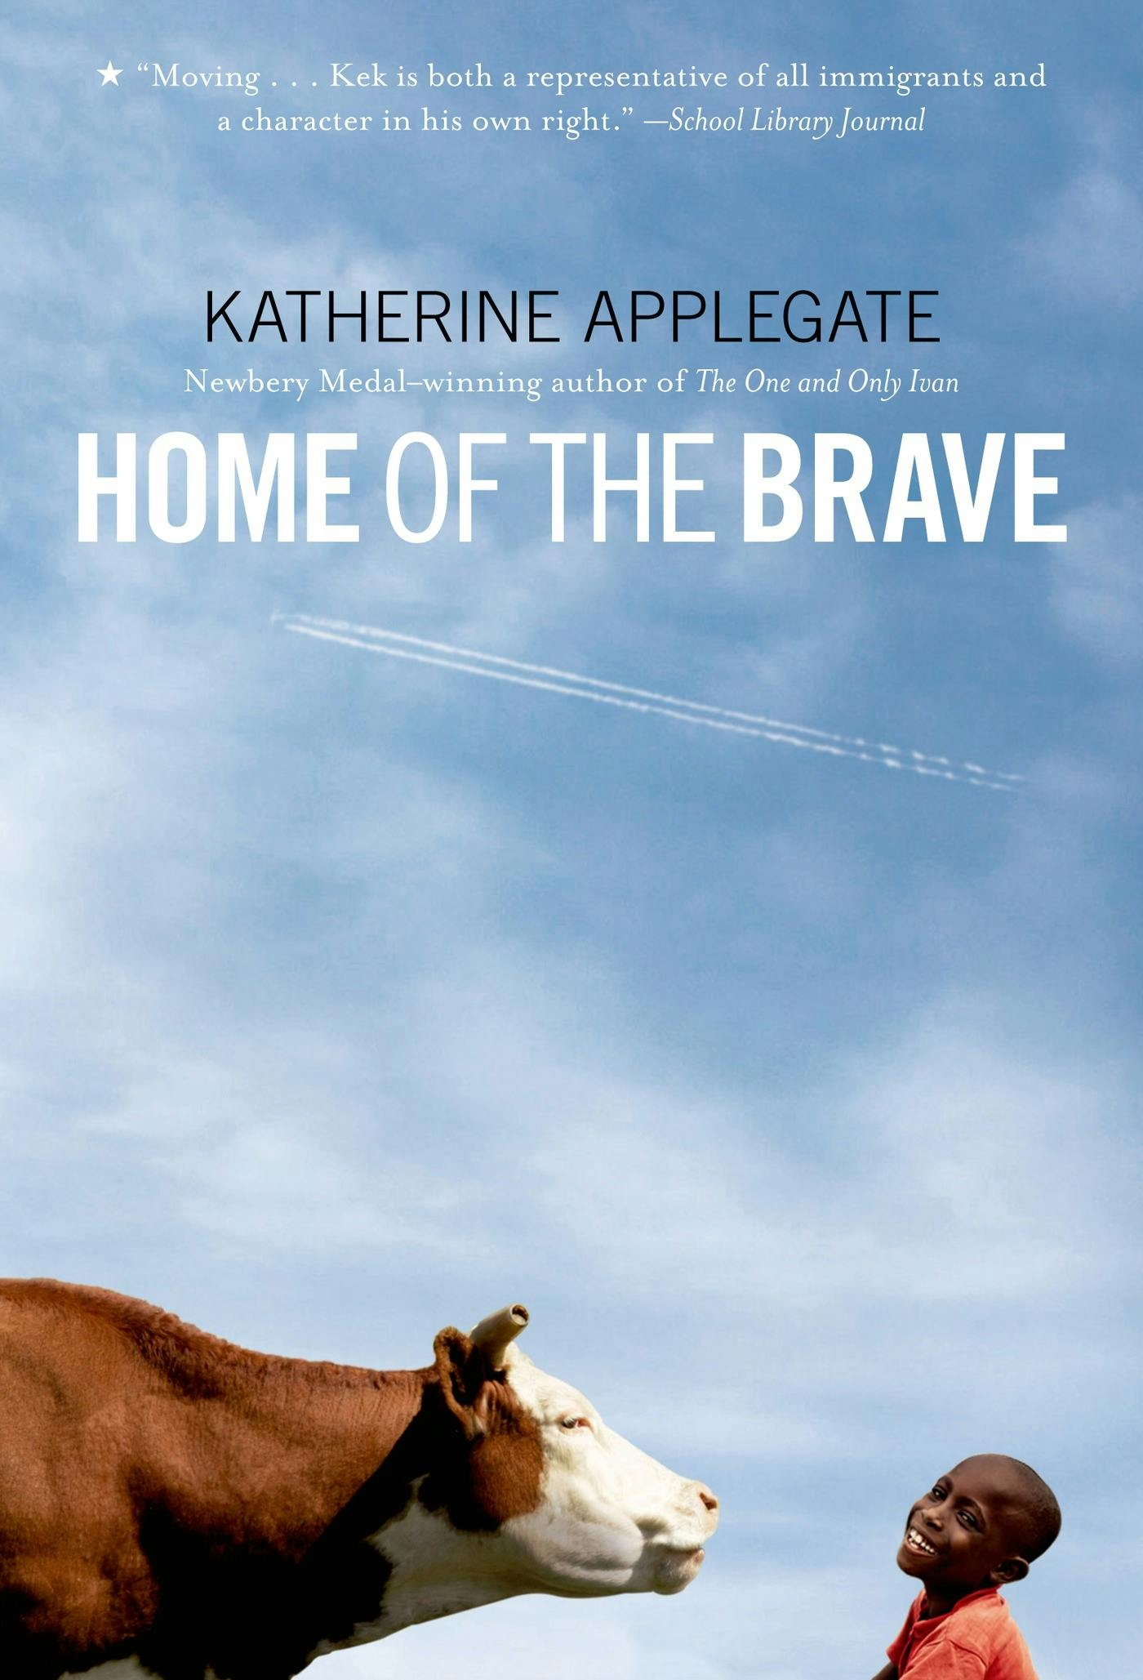
The title of the novel: Home of the Brave
Think of a reason why this is a very American title.
Home of the Brave is very American, because: ……………………………………………………………………………………….. ………………………………………………………………………………………… …………………………………………………………………………………………………………………..

Slide 8
‘The Star-Spangled Banner’ – the American National Anthem (het Amerikaanse volkslied)
O! say can you see by the dawn’s early light,
What so proudly we hailed at the twilight’s last gleaming,
Whose broad stripes and bright stars through the perilous fight,
O’er the ramparts we watch’d, were so gallantly streaming?
And the Rockets’ red glare, the Bombs bursting in air,
Gave proof through the night that our Flag was still there;
O! say does that star-spangled Banner yet wave,
O’er the Land of the free and the home of the brave?
Notes:
Link naar een youtube video waarin Taylor Swift het volkslied zingt. Laat ook goed zien dat dit zelfs bij elke sportwedstrijd gezongen wordt: Bing Videos

Slide 9
Write about what you have learned this lesson
What did you learn this lesson?
Homework
Write a text about: (you can choose)
Being new in a strange land
Something that is know to you but strange to someone else (like ‘snow’)
Someone who is brave

